Slide 1

FINAL PROJECT
SALES DATA ANALYSIS AND REPORTING FOR A RETAIL CHAIN
By
SHAHINA NAAZ KHAN

Slide 2
Abstract
The sales data analysis and reporting for a retail chain involves a comprehensive examination of transaction data to uncover trends, patterns, and key performance indicators that drive business success.
Comprehensive examination of transaction data. Data cleaning and preparation to ensure accuracy. Analysis of sales performance by time, product categories, and outlets.

Slide 3
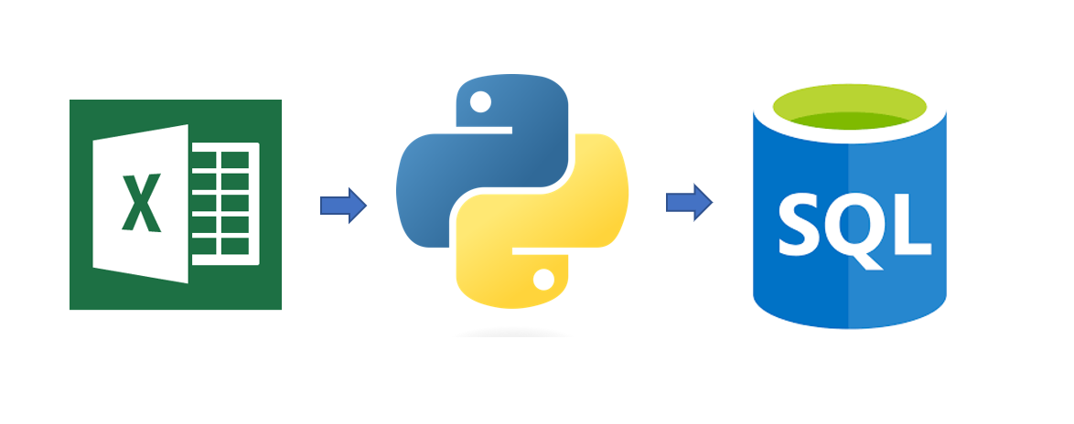
objective
This project aims to analyze sales data using Python, SQL, and Excel to generate meaningful reports for a retail chain, uncovering trends, patterns, and key performance indicators for business success.

Slide 4
METHODOLOGY
Data collection from Kaggle.com. Use of MySQL for maintaining and querying sales data. Data cleaning, exploration, visualization and processes implemented in Python to provide us with the insights of data.

Slide 5
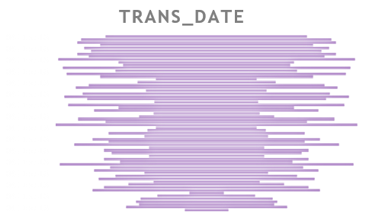
MySQL Query to visualize the graph where transaction amount is 70.
MySQL QUERY TO VISUALIZE THE GRAPH WHERE TRANSACTION DATE IS 4TH DECEMBER 2013.

Slide 6
Which 3 months have had the highest transaction amounts?
 | month | Tran_amount
0 | 8 | 726775
1 | 10 | 725058
2 | 1 | 724089
Customers having highest number of orders?
 | Customer_id | count
0 | CS4424 | 39
1 | CS4320 | 38
2 | CS3799 | 36
3 | CS3013 | 35
4 | CS1215 | 35

Slide 7
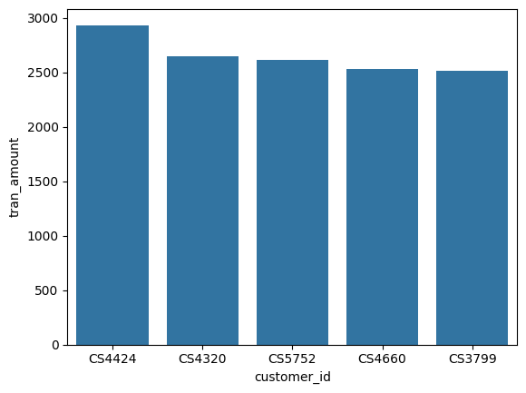
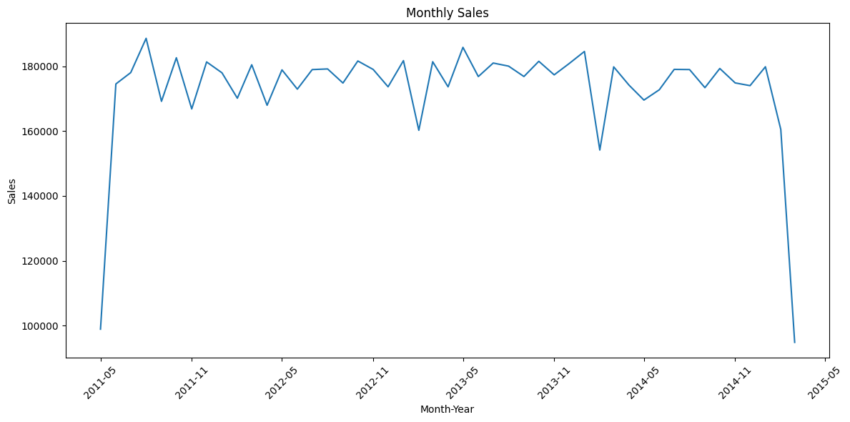
time-series of monthly sales
Customers having highest value of orders

Slide 8
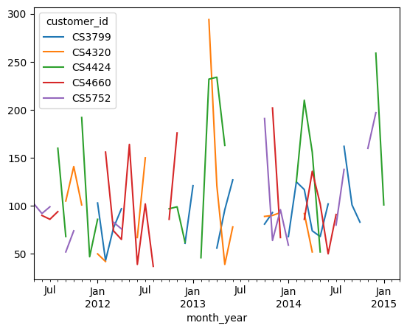
Total transaction of sales
Analysing Top 5 Customers

Slide 9
CONCLUSION
Valuable insights on sales performance dynamics. Optimized inventory and targeted marketing strategies based on analysis. Support for decision-making regarding resource allocation.

Slide 10
THANK YOU

